Slide 1
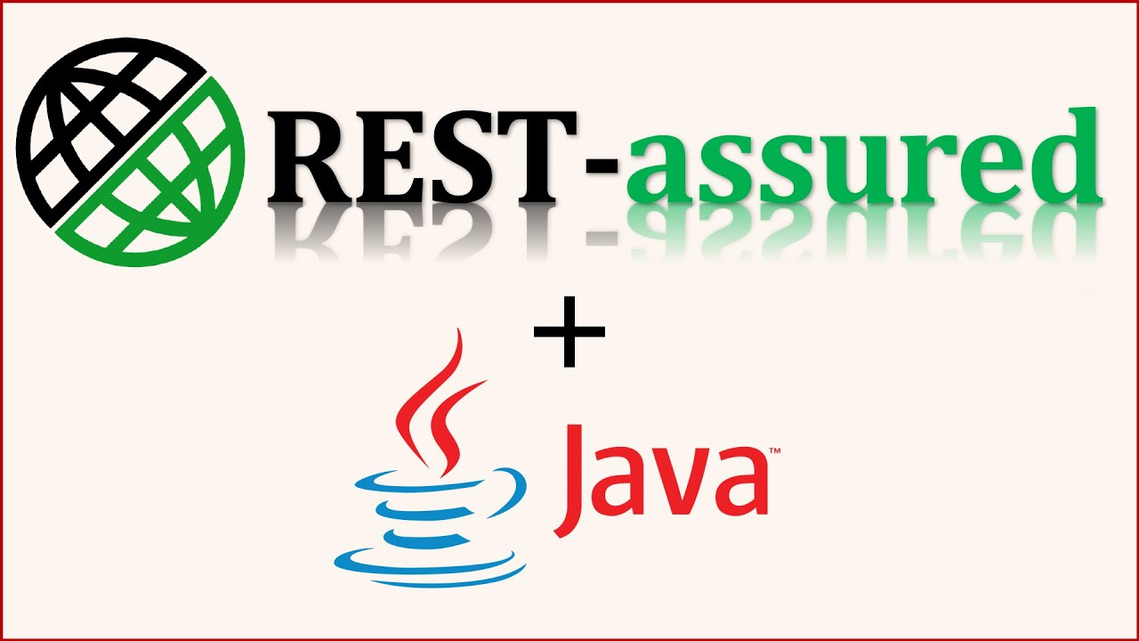

Slide 2
Rest Assured Introduction
Rest Assured is a popular open-source Java library specifically designed to make testing and validating REST (Representational State Transfer) APIs simple and efficient.
Think of it as a tool that lets you write automated tests for your web services in a way that is highly readable and easy to maintain.
Rest Assured is a Java-based library used for testing and validating RESTful APIs. It makes it easy to send HTTP requests (like GET, POST, PUT, DELETE) and verify responses in a simple, readable, and BDD-style syntax.

Slide 3
given(), when(), and then()
The most defining feature of Rest Assured is its BDD (Behavior-Driven Development) style syntax. It structures your tests into three clear parts, making them read almost like plain English.
given()
when()
then()

Slide 4
given() - The Setup or Precondition
The given() method is used to prepare the request. This is where you set all preconditions and provide the data that needs to be sent to the server.
This defines the request setup — such as headers, parameters, body, authentication, etc.
Syntax: given()
.baseUri("https://growskillit.com")
.header("Content-Type", "application/json")
.body("{ \"name\": \"Manas\" }");
Use given() for:
Base URI / Base Path
Query parameters
Path parameters
Request body
Authentication
Headers

Slide 5
when() — Action / Request Execution
The when() method signifies the execution of the HTTP request. It's the "action" part of the test. You chain the specific HTTP method you want to perform (like GET, POST, PUT, DELETE) onto the when() method.
This specifies what action you’re performing — the actual HTTP request.
Syntax: when(). post("/api/users") // Perform the POST request on this endpoint
Use when() for:
Sending HTTP requests (get(), post(), put(), delete(), etc.)
Including the Resource in method/request

Slide 6
then() - Validation
The then() method is where we validate the response we get back from the server. This is the "assertion" part of your test script, where we will check if we received what we expected.
Syntax: then(). log().all().
statusCode(200).
body("job", equalTo("leader")).
body("id", “1342" ) // Using Hamcrest matchers
Use then() for:
Verifying status code
Validating response body
Checking headers
Extracting response data for further checks

Slide 7
Summary
Keyword | Purpose | Typical Use
given() | Setup/Preconditions | Base URI, headers, body, params
when() | Performing Action | Send GET, POST, PUT, DELETE request
then() | Verify response/Validation | Check status code, body, headers

Slide 8
Why Use Rest Assured?
Excellent Readability: The given/when/then syntax makes tests self-documenting and easy for anyone (even non-technical stakeholders) to understand.
Seamless Integration: It's a Java library, so it integrates perfectly with popular testing frameworks like JUnit and TestNG. You can run your API tests as part of your standard build and CI/CD (Continuous Integration/Continuous Deployment) pipeline.
Powerful Validations: Rest Assured has built-in support for powerful assertion matchers (using Hamcrest) and allows for easy validation of JSON and XML responses using "path" expressions (like JSONPath and XMLPath).
Easy to Set Up: You just need to add it as a dependency (e.g., in your Maven pom.xml or Gradle file). There's no complex setup required.

Slide 9
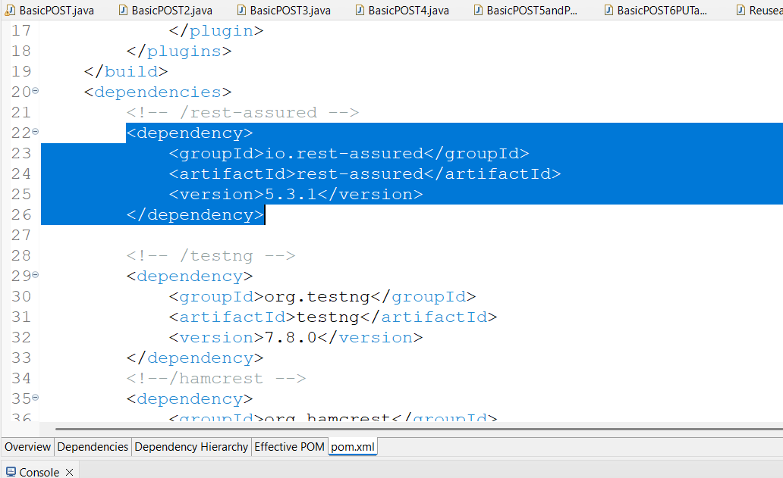
How to Add Rest Assured (Maven)
<dependency>
<groupId>io.rest-assured</groupId>
<artifactId>rest-assured</artifactId>
<version>5.4.0</version>
<scope>test</scope>
</dependency>

Slide 10
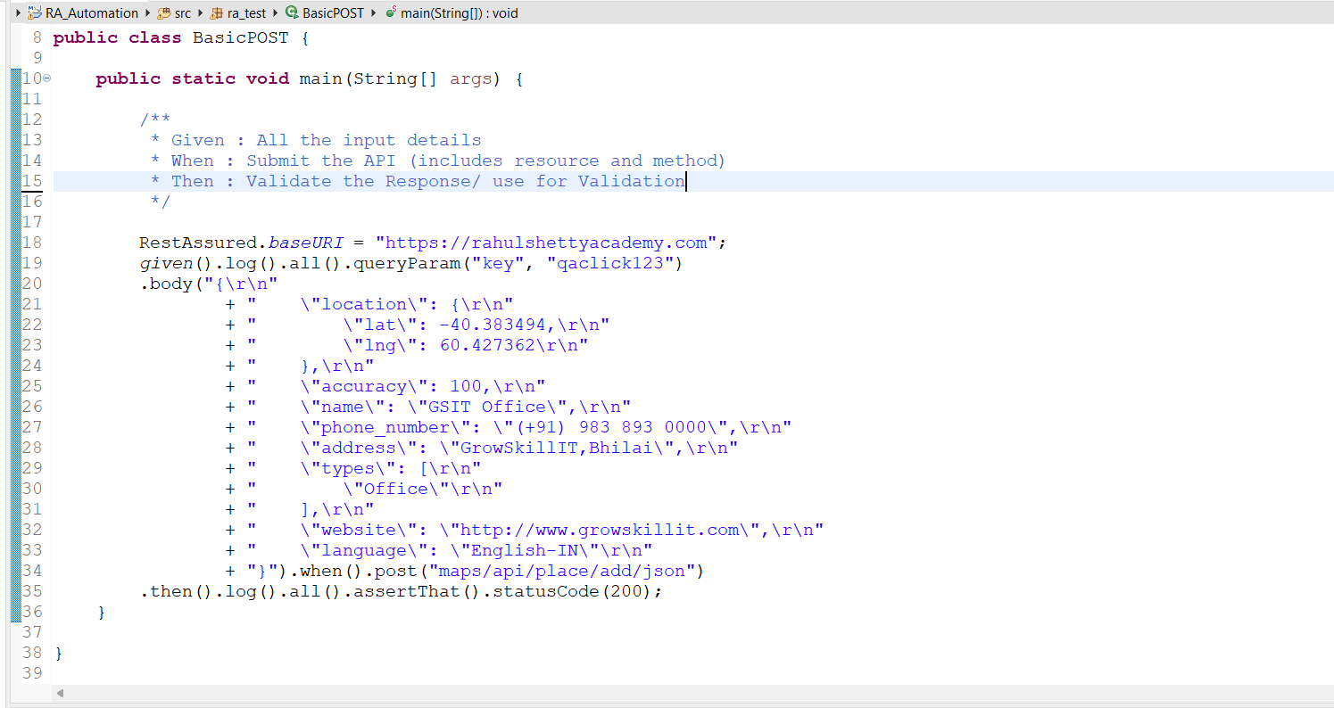

Slide 11
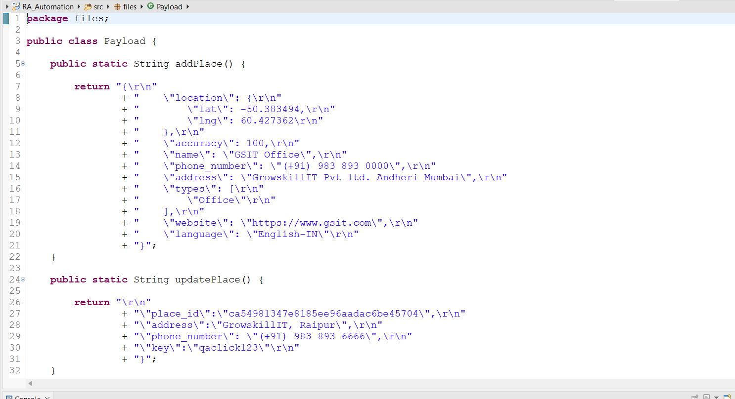

Slide 12
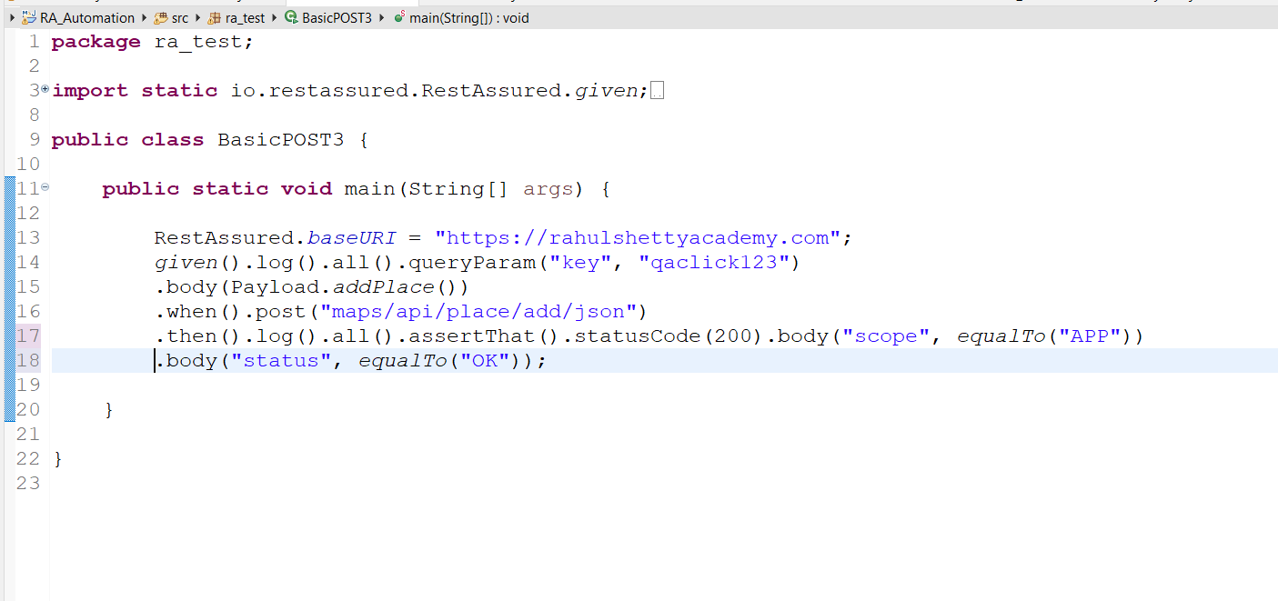

Slide 13
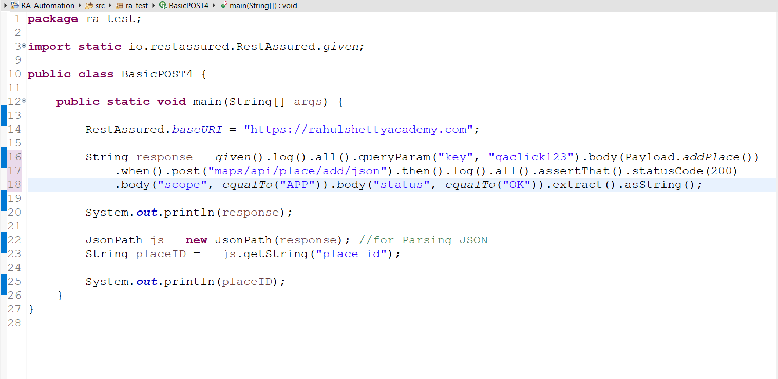

Slide 14
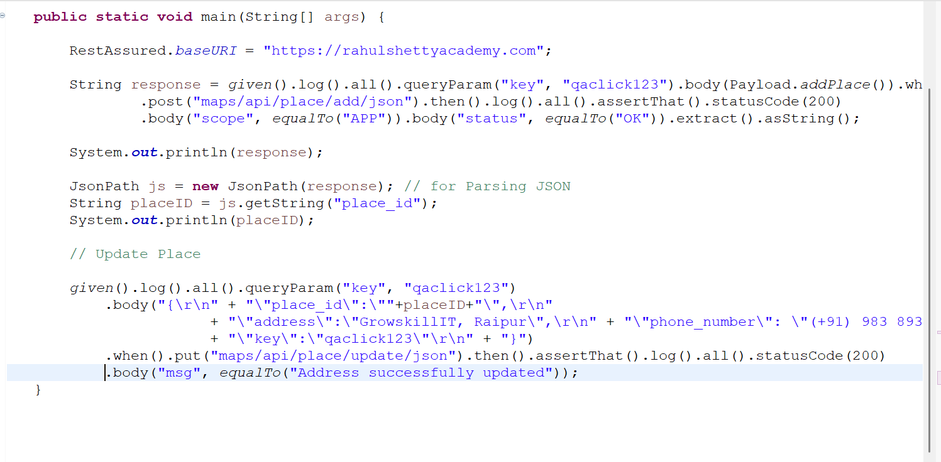

Slide 15
